Slide 1


PRODUCT AND SERVICES FOR TRANSPORT HUB

Slide 2
1
OVERVIEW OF TEAM
Team Name: The Crew
Sakshi Raut
Bhumika Rathod
Rutuja Gadhave
Mayur Jagzap
Hrushil Sonawane
Jay Jamdar
Sanjivani University | 2024

Slide 3
THEORY OF PRIORITIZATION
2
Problems | Sakshi | Bhumika | Rutuja | Jay | Mayur | Hrushil Total
1. Maintenance and downtime | 10 | 10 | 1000 | 100 | 10 | 10 1140
2. Damage and loss of goods | 100 | 100 | 100 | 1000 | 10 | 100 1410
3. Lack of real time traffic updated | 100 | 1000 | 10 | 100 | 1000 | 1000 3210
4. Stockouts and overstocking | 100 | 100 | 1000 | 10 | 10 | 1000 2320
5. Product safety | 1000 | 1000 | 100 | 100 | 10 | 10 2220
sanjivani University | 2024
High rated topic :
Lack of real time traffic updated

Slide 4
3
PROBLEM STATEMENT
Commuters and transport authorities lack on accurate real time tracking system for public transportation . Leading to uncertainty in vehicle arrival time .
Sanjivani University | 2024

Slide 5
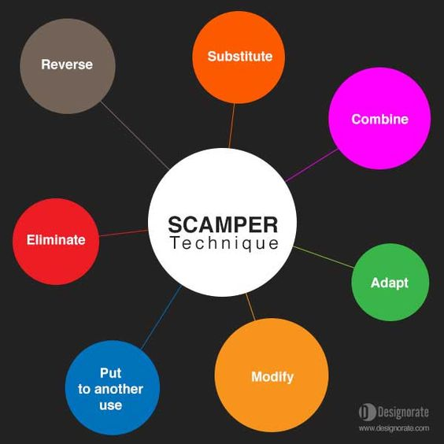
SCAMPER ACTIVITY
4
Substitution : many of the substitute mention such as electric vehicles in renewable energy directly address the problem of emissions and pollution at transport hub
Eliminate : For a transport hub , this method can help streamline operations, improve customer experience, and reduce unnecessary overheads .
How It Works ?
Simplification of services
Reducing waiting time
Cost reduction
Sustainability
sanjivani University | 2024

Slide 6
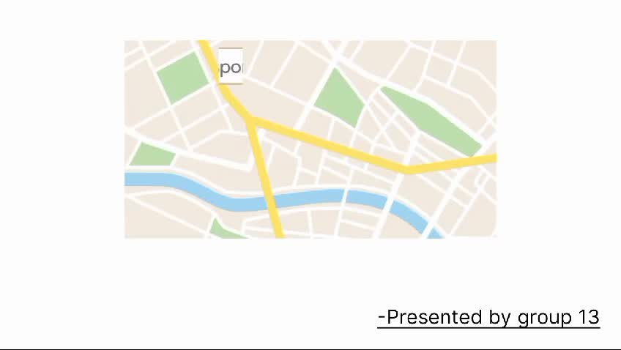
Prototype app or 3D model

Slide 7
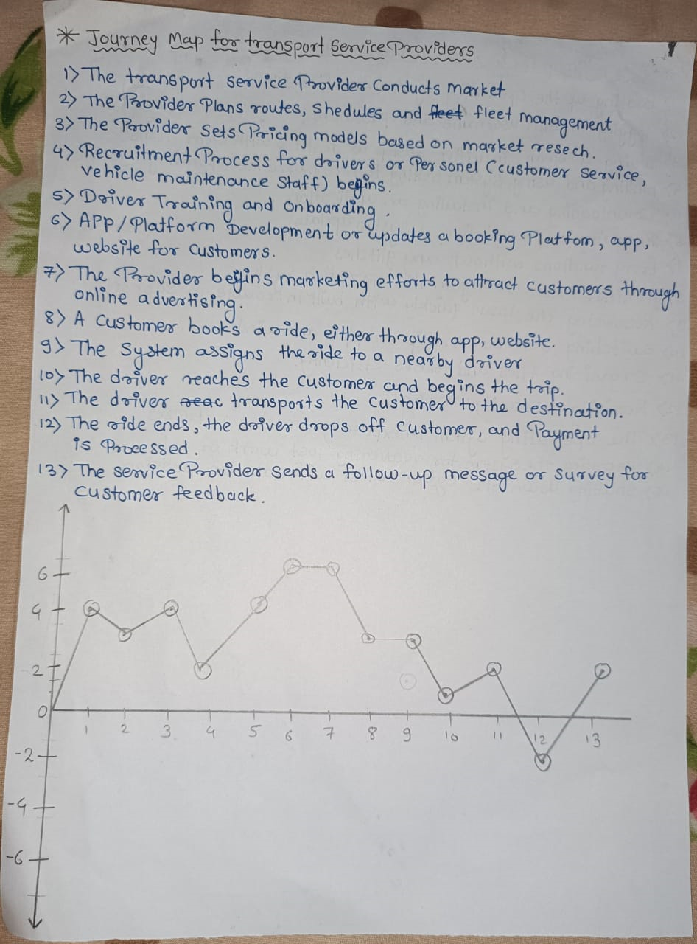
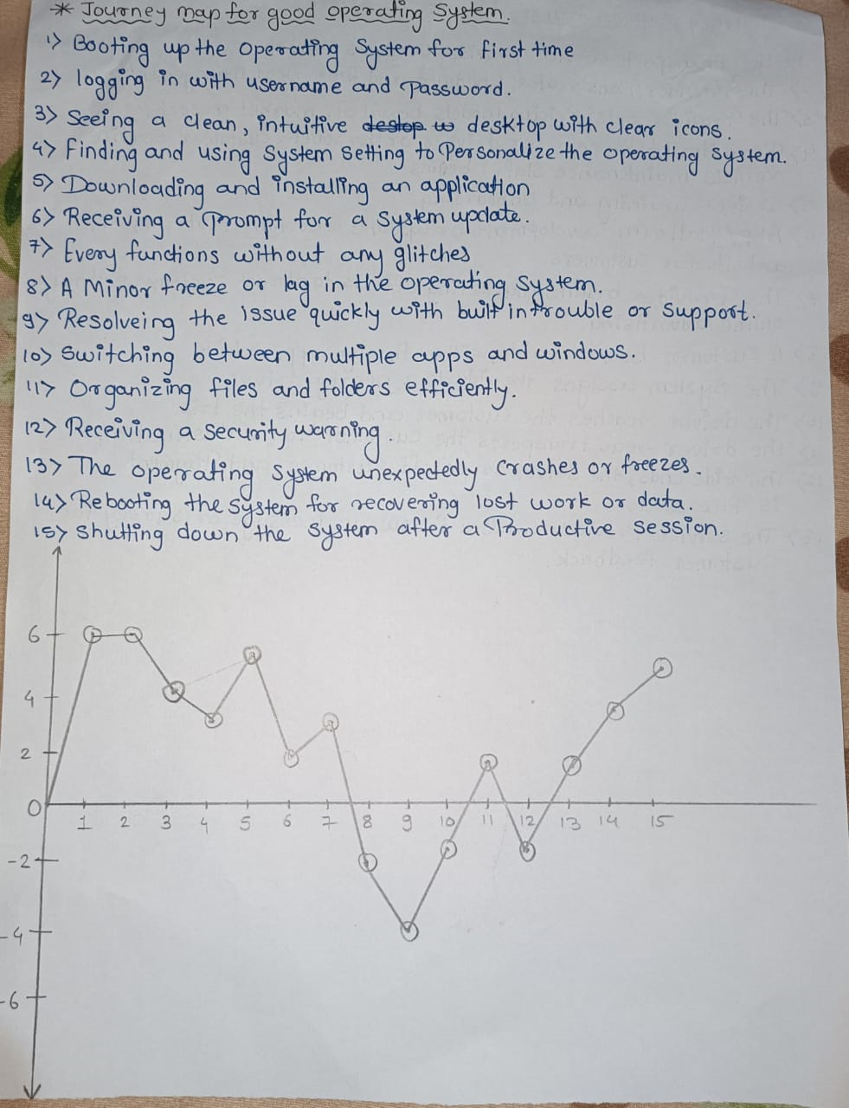
Journey Map

